Slide 1

Cs4804-c25 Final project NBA MVP stats
Process Book by Michael Neff & Jacob Silvester

Slide 2
NBA Player Data
In recent years, sports have increasingly become more data driven, and stat focused. The NBA is no exception, and stat sites have adapted as such, developing different ways to calculate and express player impact. As such stats are created and measured, it can be overwhelming, especially to more casual NBA fans to access and view the data in a meaningful manner.

Slide 3
Our project
Even with a wide array of statistics and visualizations available, we still found key areas where innovation could be had. One such area, was visualizing the outcomes of player possessions. In a sport where one player can dominate the ball, we sought a way to be able to show the outcomes of what happens when a given player gives up the ball be it a shot, pass, turnover, etc. While these numbers are widely available in chart form, we did not see common expressions of this data in a visualization format. Our initial intention is to use a Sankey diagram to show the “flow” of a given players possessions.

Slide 4
Scope
Initially we wanted to be able to produce these visualizations for all players who participated in the 2023-2024 NBA regular season. However, after exploring the datasets we intended to use, as well as mocking up early stages of our diagrams, thought it best to pivot to a more concise scope.
Our second idea was to focus on players who received MVP votes, thus limiting the number of player to collect data on and ensuring that the players had enough data as players considered for an award such as MVP would generally have to have played above a certain threshold of games to be considered. With a smaller number of players to incorporate, we could then focus on comparisons between the players as well, rather than simply displaying data.

Slide 5
Our question
Our main question we sought to answer is can we display the offensive impact that MVP-caliber players have on their team and determine how much weight is put into offensive production when considering players for the award.

Slide 6
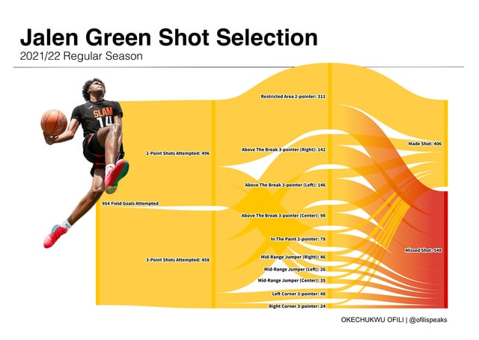
Related works
We were partially inspired by existing NBA Sankey diagrams, but they weren’t as all encompassing as we were trying to make ours. This is a diagram that shows shot types for a player in a given season. Sankey diagrams did not seem to be a popular visualization type in the NBA space, outside of a few niche examples like this, and so we thought we found room to expand

Slide 7
Dataset
https://www.pbpstats.com/season-stats/nba?EntityType=Player&EntityId=2544
The above link is the main source of our data. Called PBP stats, this site is one of the most complete databases of NBA data we could find. Data for all players in each season are available, with breakdowns involving everything from basic counting stats, to move advanced analytics and percentages. We were able to use a direct API to pull stats we were looking for into our repository.

Slide 8
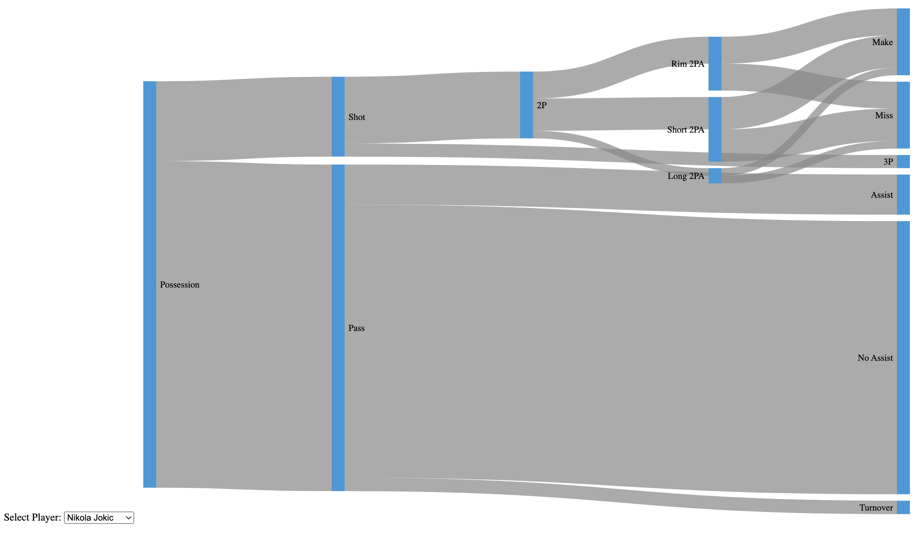
1st sketch of display
This is our first early version of just testing how the data can be displayed, experimenting with website layout. We wanted to see how the bars would look, and where overlap may occur. As well as seeing how much we could reasonably display.

Slide 9
Goals for next version
While we were mostly happy with the actual data display, our goal had shifted to more of a comparison between players compared to just displaying single players at a time. Therefore, we wanted to begin prototyping for showing multiple players on the same diagram. We thought about ways to either color code or break up the nodes by player.

Slide 10
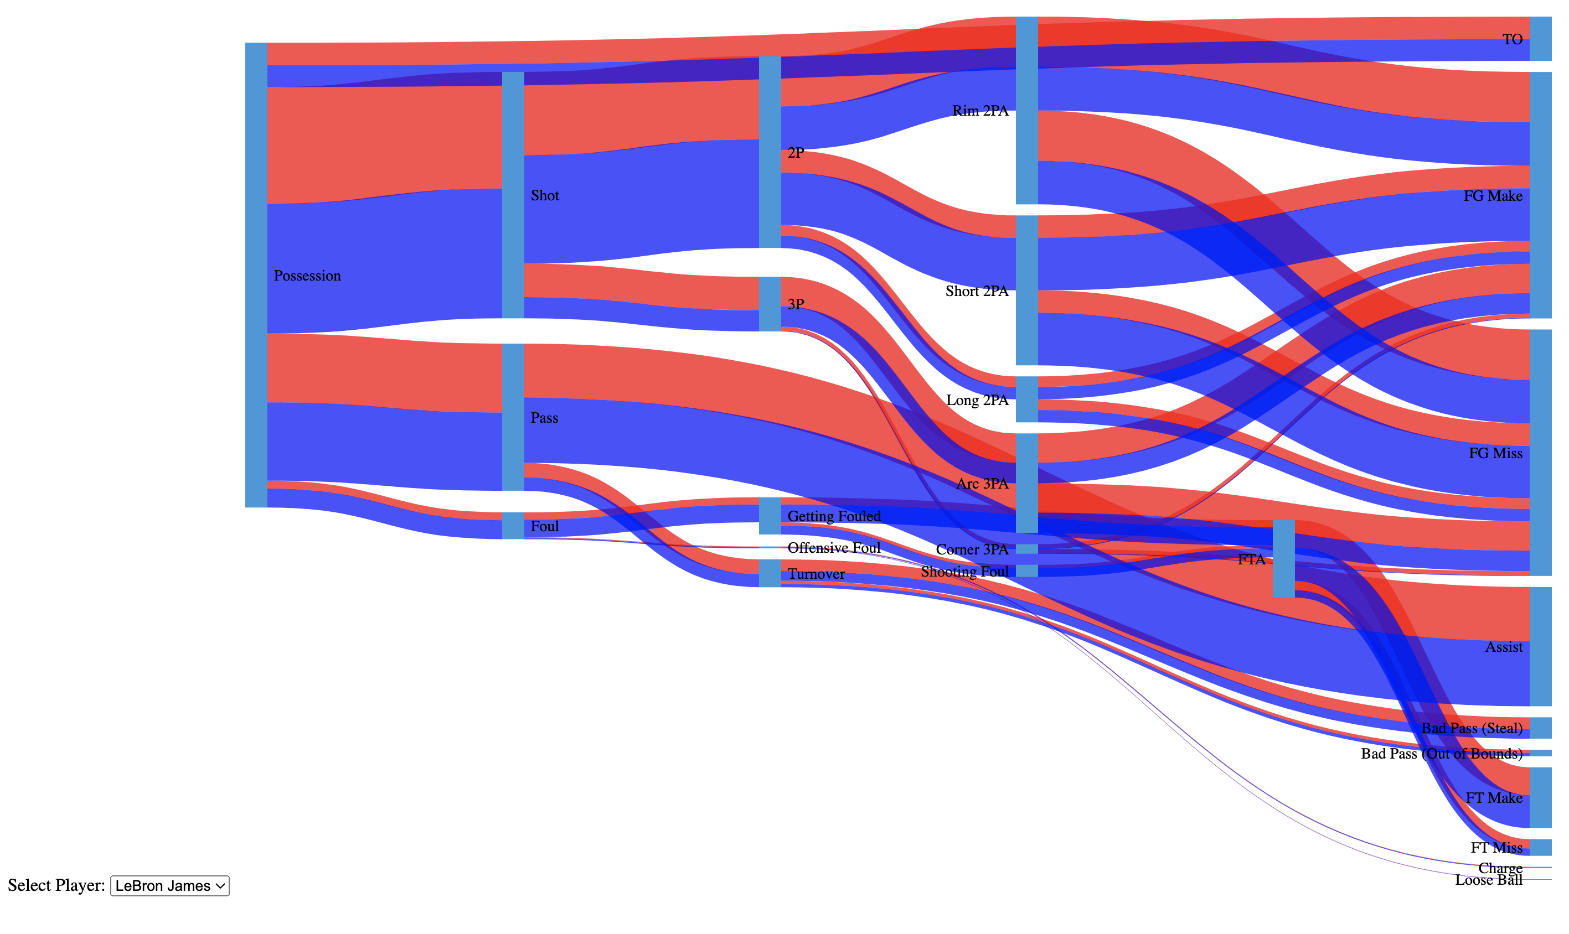
2nd sketch of display
This is a second iteration of the data being displayed. We wanted to be able to show more of a comparison between two players being selected. Each color represents one player. And their individual amounts of each stat are represented per node.

Slide 11
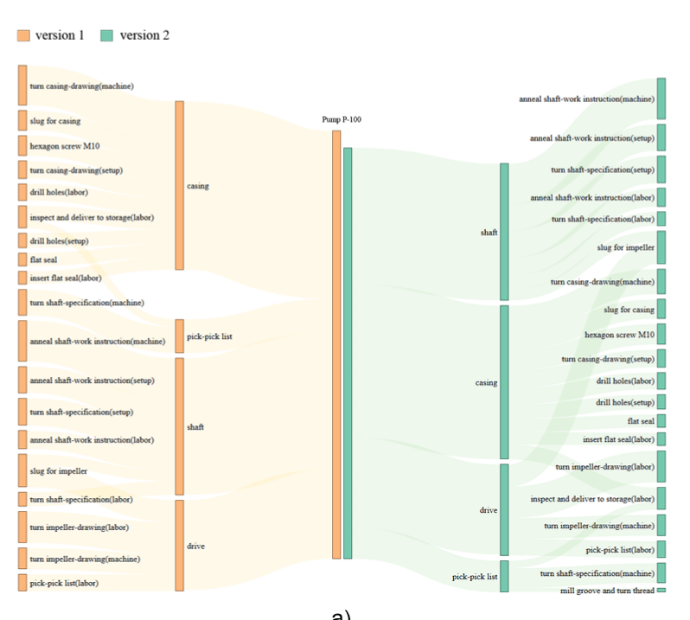
Goals for next version
We thought that the readability needed to be enhanced, so we tried a new idea for the layout inspired by a paper on Sankey diagram comparisons. Instead of superimposing the data, we had both players with their own diagram with the same starting category node in the middle, and then the diagrams branch in opposite directions. The user can select a category to be highlighted in both diagrams for direct comparison.
Notes:
Vosough, Z., Kammer, D., Keck, M., & Groh, R. (2018, January). Mirroring Sankey Diagrams for Visual Comparison Tasks. In VISIGRAPP (3: IVAPP) (pp. 349-355).

Slide 12
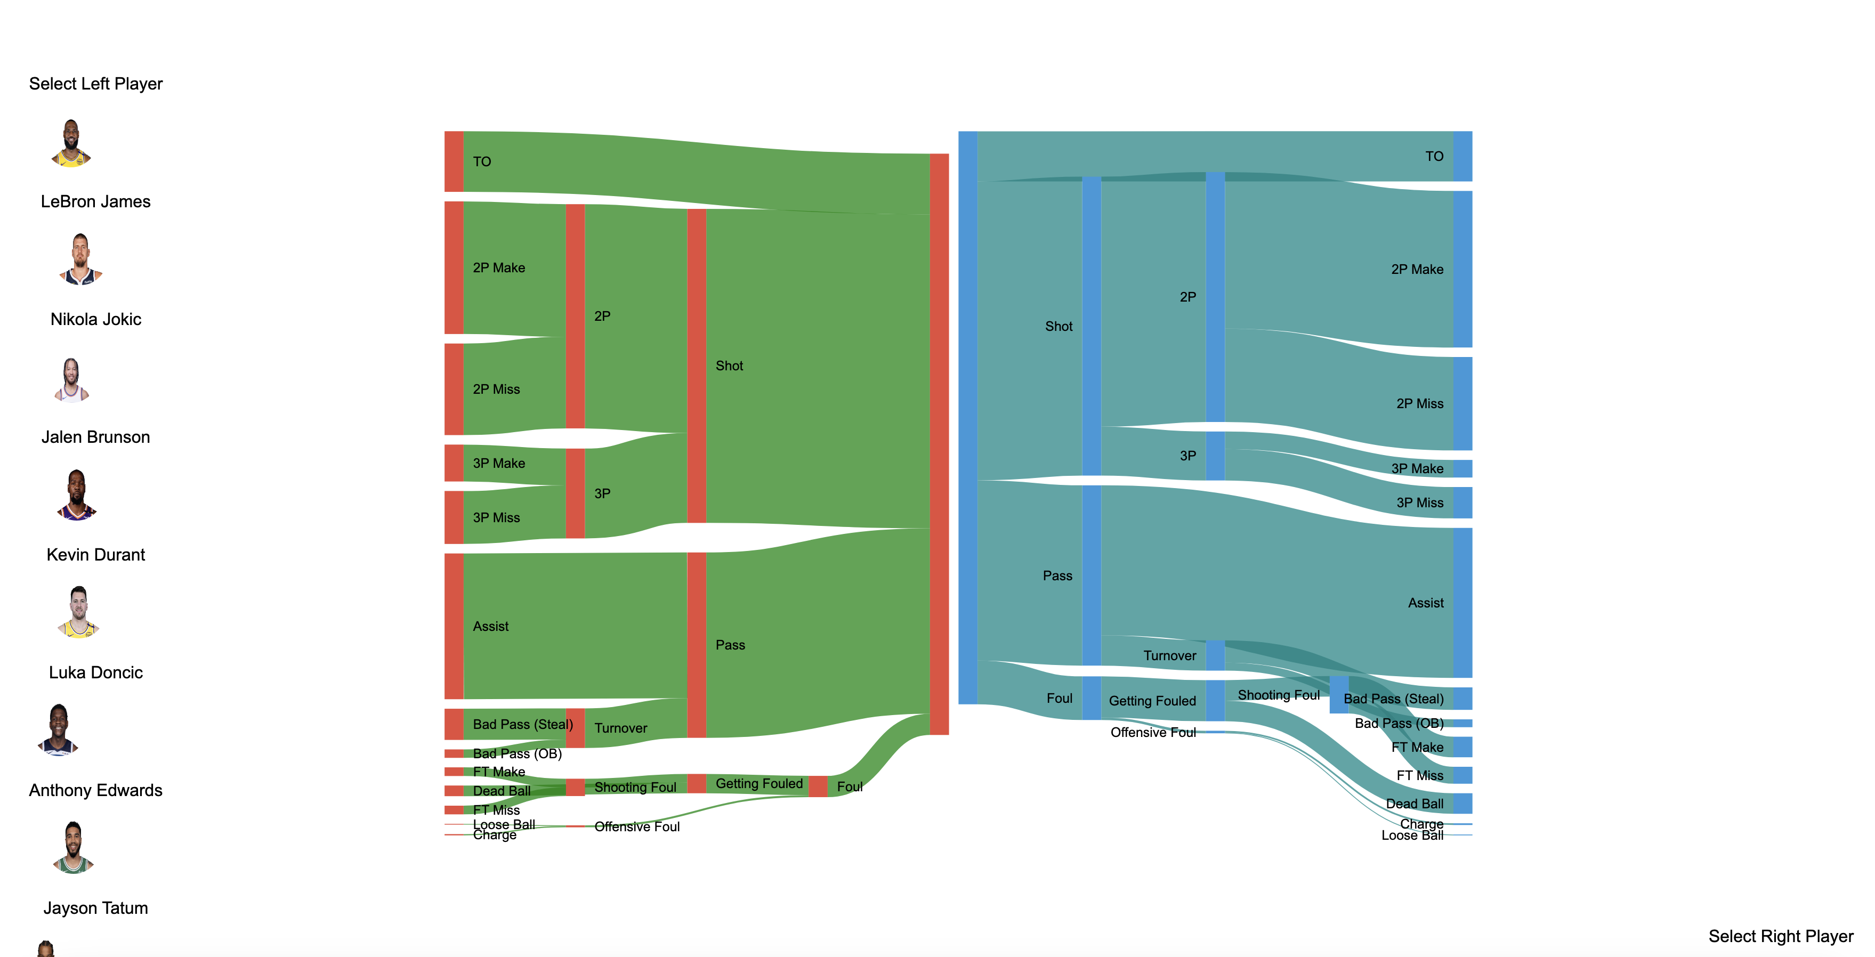
3rd Implementation
This implementation focused on being able to compare between 2 players the user could select, and we used the previously mentioned paper as a source of inspiration.

Slide 13
Goals for next iteration
In our third iteration, we wanted to focus on comparison and feel as though the idea we adapted from the paper worked well with maintaining readability. We had one major function we wanted to add though which was the ability to highlight a statistic for both players in to directly compare specific categories. Outside of that our goals for the final iteration were mostly design oriented. Changing the background from a basic white, potentially playing around with color, finalizing the player selection options, and other general css type stuff to polish the page.

Slide 14
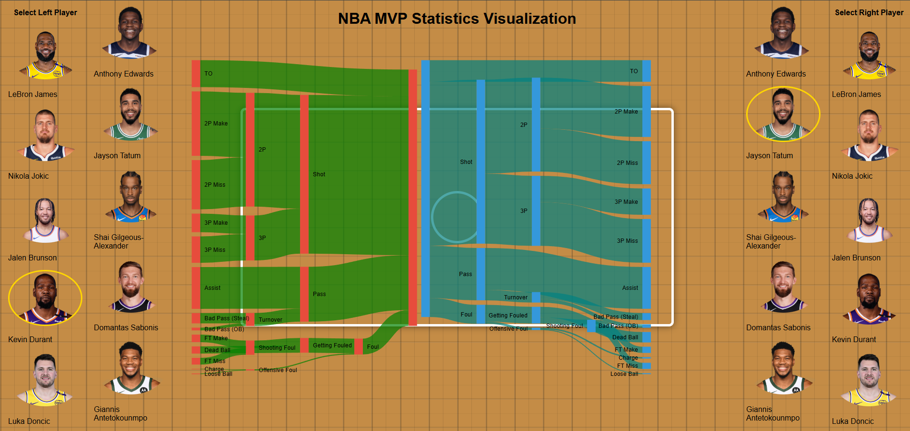
Final implementation

Slide 15
Final Product and moving forward
Initially we set out to see if we could, in a new way, show and compare NBA players to one another. We would say that, while not perfect, our visualization is promising at least when it comes to more basic counting metrics for the NBA. It would likely not be effective for more complex analytics. But for what it does show, we believe it shows it well, and in a fresh, new way not widely see in the NBA data space right now.
We would want to add relatively simple details we couldn’t for times sake. One would be scaling up to have more than just MVP candidates, as well as including more years. There are also other stats to be included as well. Some minor improvements to the diagrams themselves such as alignment, and readability tweaks could also be added.

Slide 16
logistics
A lot of the coding was done together as we thought this would be an effective way to ensure we both had familiarity with the code, although the typing was mostly done by Michael. Jacob handled most of the design stuff, preliminary research, and kept the records for the process book.

Slide 17
conclusion
Overall, we thought this was a very rewarding look into the NBA data visualization space. While not a perfect solution, we feel like we gained a new appreciation and understanding about ways to visualize player stats. It affirmed what we expected in that a lot of top players play similarly, but subtle quirks will appear, and our visualization tries to show that in an approachable way beyond just looking at stat lines.

